Slide 1
TestComplete/TestExecute Overview

Slide 2
TestComplete vs TestExecute
TestComplete:
Functional tests creation and execution: Desktop, Web, Mobile
TestExecute:
Functional tests execution only: Desktop, Web, Mobile

Slide 3
Common features
Test recording
Object searching
Logging
Events processing
Distributed testing
Integration with third party systems

Slide 4
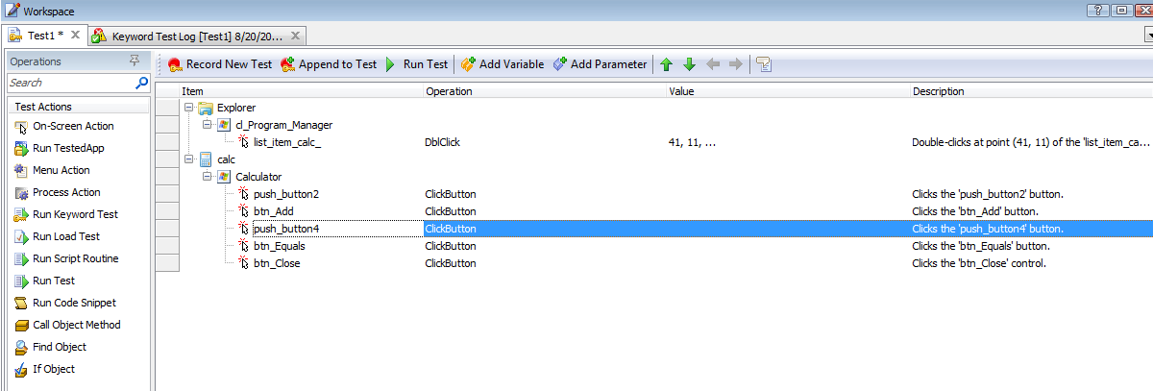
Test Recording
Possibility of recording of user actions and their replicating
Trivial conditions and verifications
Possibility to convert to script

Slide 5
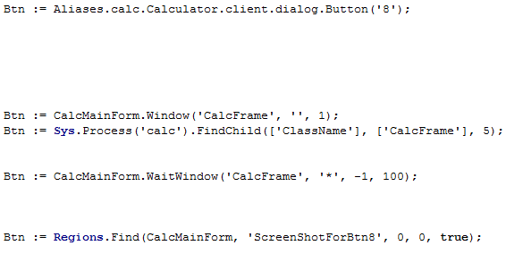
Object Searching
Full name
Properties
  Getting
  Waiting
Image

Slide 6
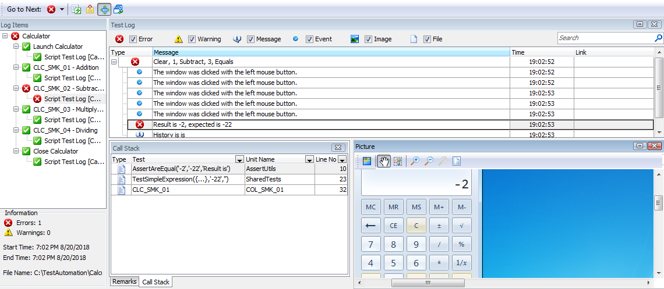
Logging
5 message types: Error, Warning, Message, Event, Checkpoint
Screen shots, Call stack, Messages tuning and filtering

Slide 7
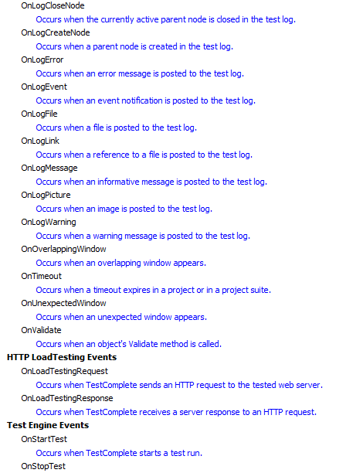
Events processing
Examples:
Test start/finish and errors marking in some simple log
Unexpected/overlapping window smart processing

Slide 8
Distributed testing
Ability to distribute testing for a few slave machines and manage them from a master
Error logs are collected in a master

Slide 9
Third parties integration
Unit testing frameworks — incl. Selnium WebDriver (Junit, TestNG)
IDE: Visual Studio, ReadyAPI, SoapUI, LoadComplete, AQTime, REST API
CI: Jenkins, Bamboo, TFS, Ms Build Engine
Source control systems, issue-tracking systems, QAComplete

Slide 10
Resources
TestComplete documentation: https://support.smartbear.com/testcomplete/docs/index.html
TestComplete forum: https://community.smartbear.com/t5/TestComplete/ct-p/TestComplete_forum
TestComplete guide in Russian:https://alpaev.com/testcomplete/
Cracked TestComplete (v. 7.52):https://rutracker.net/forum/viewtopic.php?t=3380712

